Slide 1
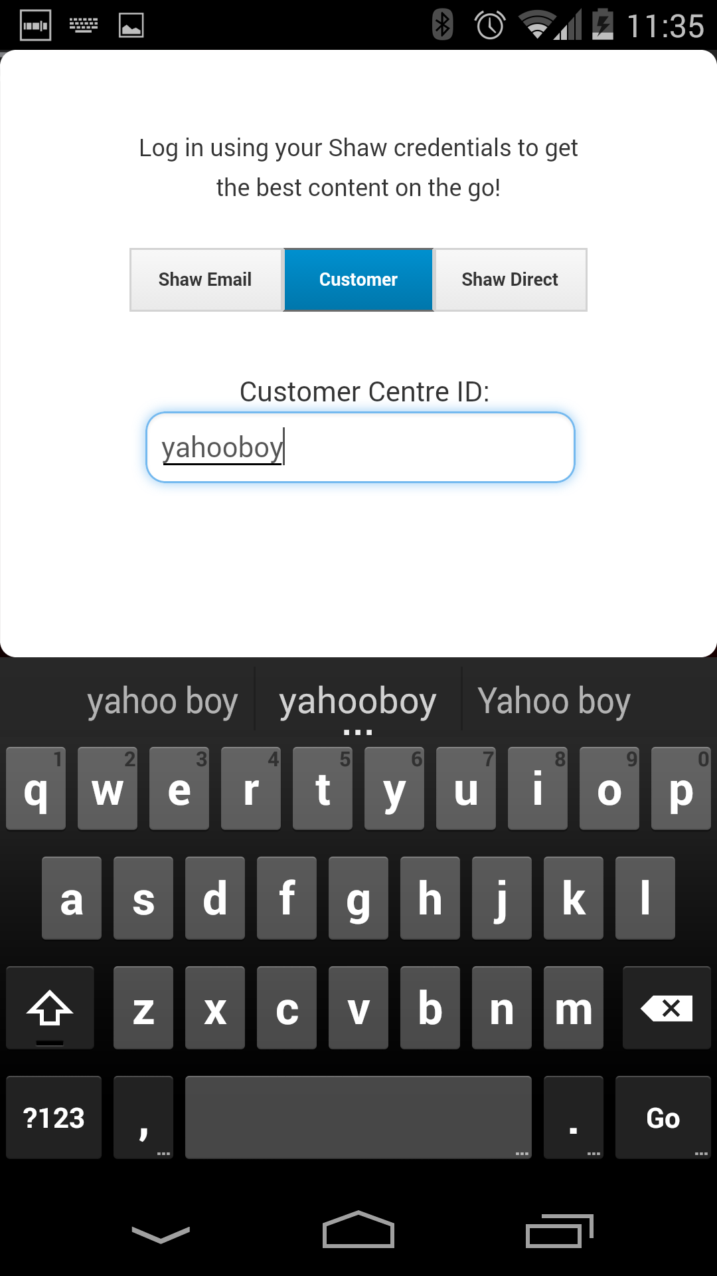

Slide 2
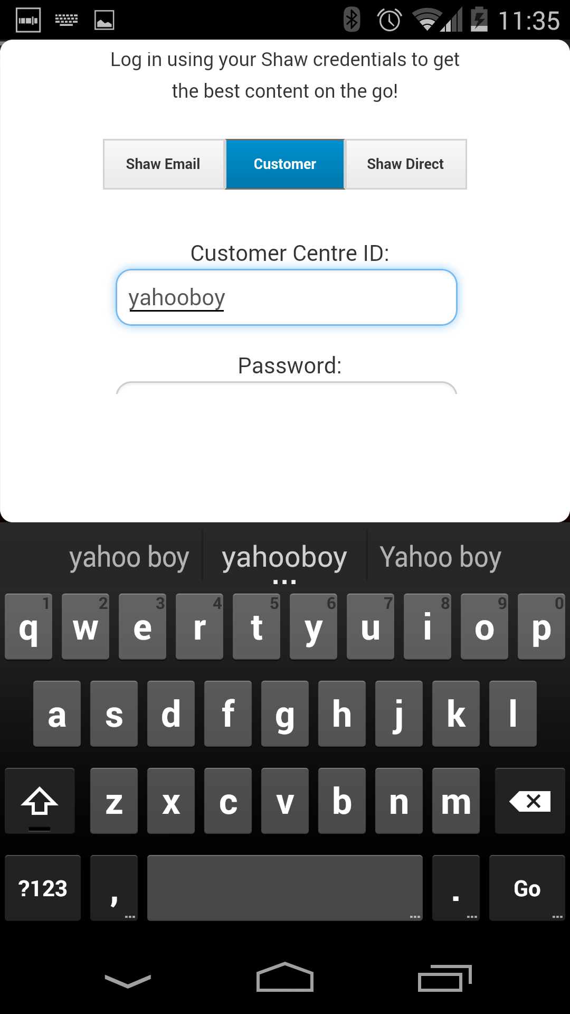

Slide 3
481 – Lecture 10 - Sketching
Exercises

Slide 4
Questions
Why should we sketch?
What is the difference between getting the design right vs. getting the right design?

Slide 5
You are designing an application (website, mobile app, etc.) for a company that produces an annual book of coupons for local businesses
Who would you talk to?
What would you try to find out?
What are things that are important for such a design?
Sketch: What might this interface look like?
Sketch: How might it work?
Sketch: How do you imagine the usage “flow” to work? (how would someone use this in their lives)
Do this with a partner. (5 mins)

Slide 6
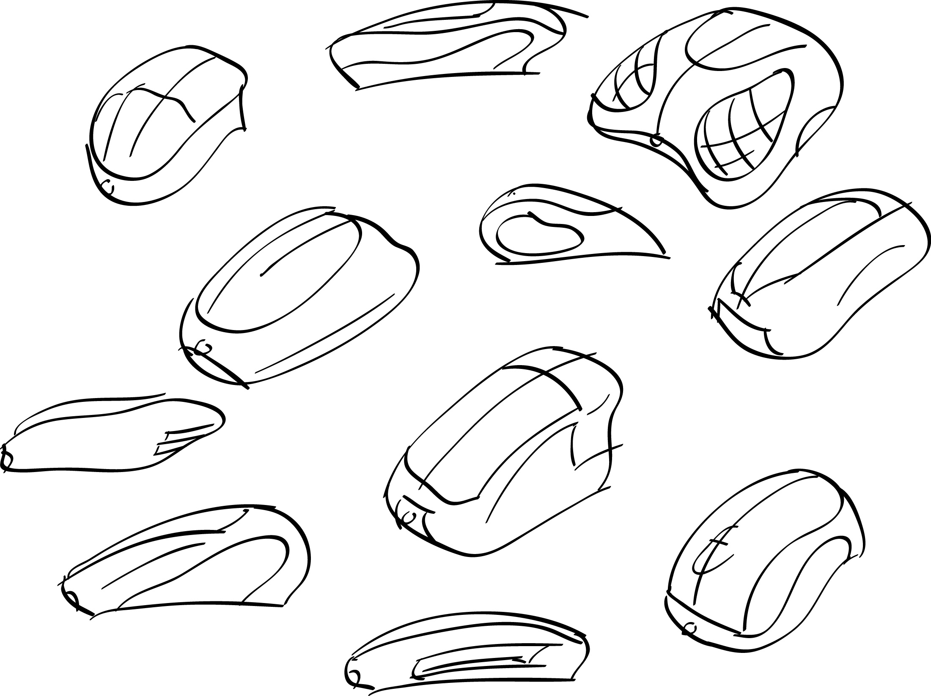
Is this a sketch? Why or why not?
Notes:
http://www.coroflot.com/cbastain/sketching

Slide 7
Is this a sketch? Why or why not?

Slide 8
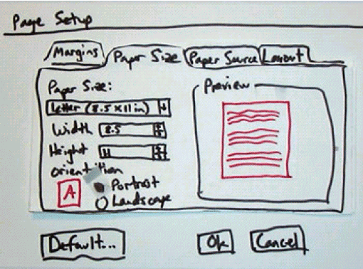
Is this a sketch? Why or why not?

Slide 9
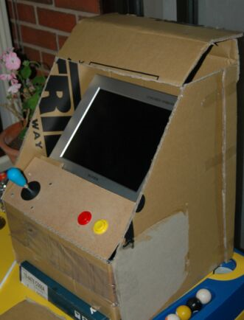
Is this a sketch? Why or why not?

Slide 10
Is this a sketch? Why or why not?

Slide 11
Quickly… Sketch 5 variations of…
A chair
A mouse
A GUI interface for adding items from one bucket to another bucket
Pair & share

