Slide 1
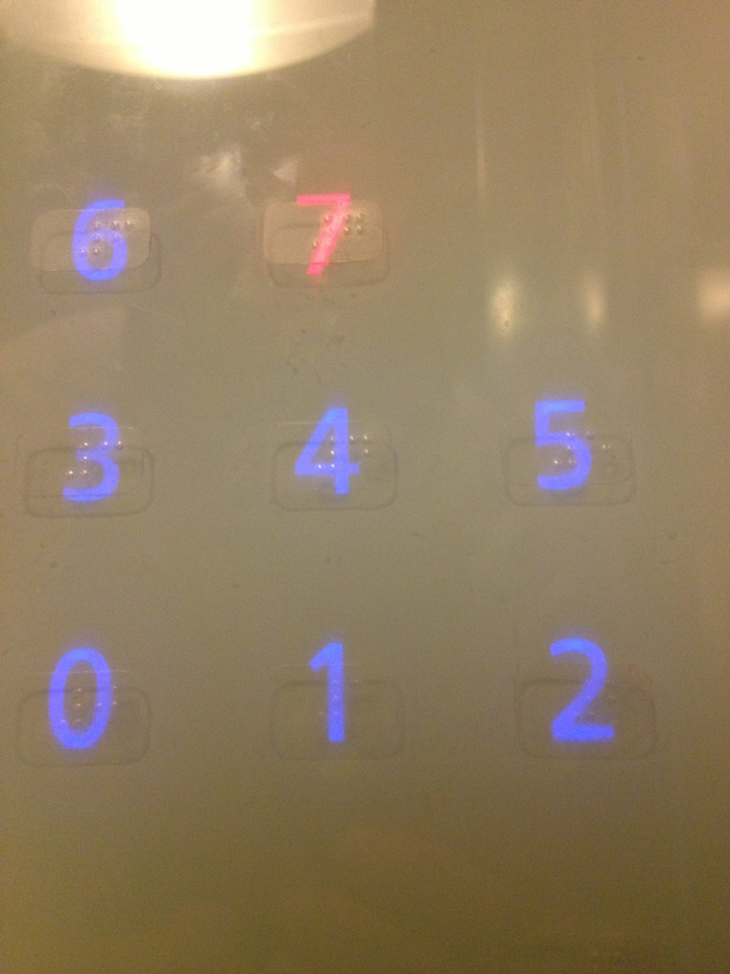
While you are looking at the picture, check out:
http://hcitang.github.io/481
Sign up on slack:
http://cpsc481-ucalgary.slack.com

Slide 2
Course Introduction
CPSC 481: HCI I

Slide 3
Foundations of Human-Computer Interaction
Foundations of Human-X Interaction
Foundations of Design for Human-X Interaction

Slide 4
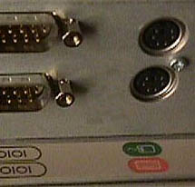

Slide 5


Notes:
www.baddesigns.com

Slide 6
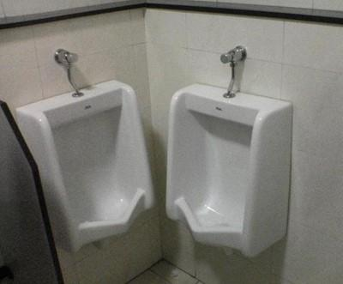
Bad Design is Everywhere

Slide 7
Bad Design Affects Us
Money
  A $200 withdrawal turns into $20000
  Bad font choice ➔ “,” looks like “.”
Lives: Therac-25 Radiation Machine
  Massive doses of radiation led to several deaths
  Cause: backing out and changing settings within 8s would not put the shield in place

Slide 8
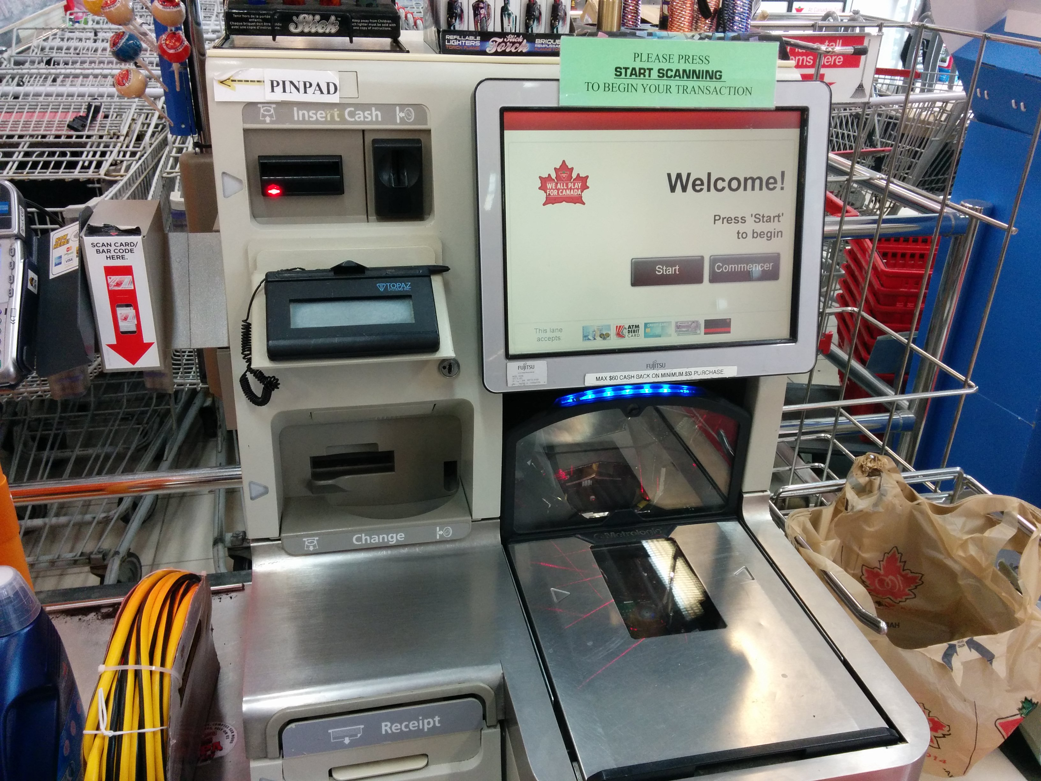

Slide 9
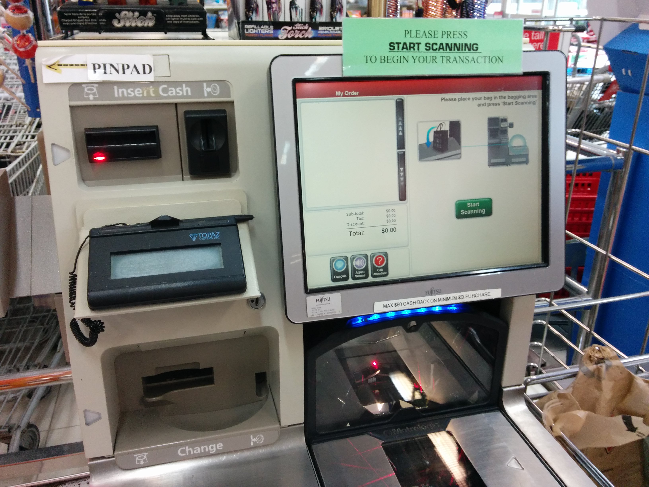

Slide 10
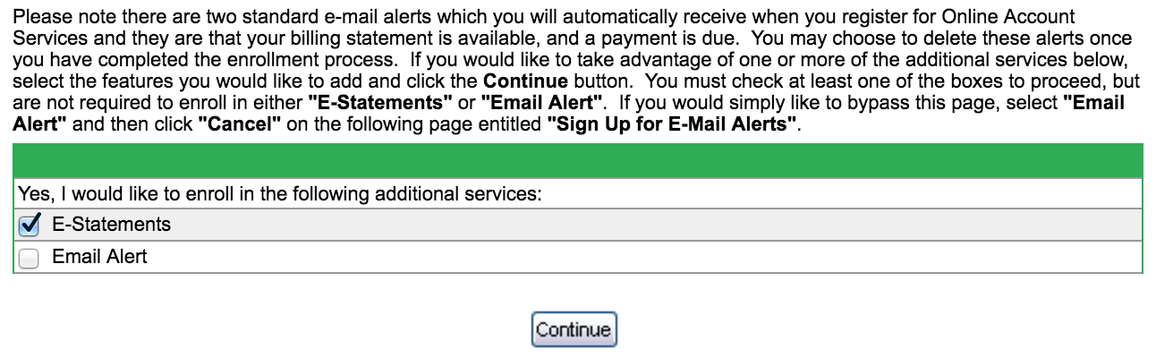

Slide 11
Anticipated snarky response: “But, I wouldn’t make those mistakes!”
Maybe, but you’re not the only one working on most projects. Your team might still make that mistake.
Here’s the problem:
You are typically not the user.
You have your own biases and blind spots.

Slide 12
What this course is about…
Understanding why bad design is so prevalent
Learning and practicing methods for “good” design
Hands-on experience with multiple design methods: involving users, prototyping, testing

Slide 13
Summary
Design is everywhere
Good design is hard
Poorly designed things have big consequences
Good design practices can help
You’re going to be a good designer

Slide 14
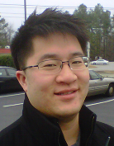
Introduction: Me
Instructor: Anthony Tang
  Call me Dr Tang, Professor Tang, Tony
  (not “Hey”)
Assistant Professor in the CS Department
  Ph.D. in Electrical and Computer Engineering from UBC
Research in Human-Computer Interaction
  Collaborative computing, personal informatics
Personal interests: Volleyball, Food, Video Games

Slide 15
Introduction: Your TAs
Terrance Mok
  MSc student
Kurtis Danyluk
  MSc student
» I made an award-winning video game
» I have a black belt in judo

Slide 16
Syllabus
Basic information
Expectations
Assessment
Assignments
Project
Labs
Office hours/contact information

Slide 17
Basic Course Information
Website
  http://hcitang.github.io/481
  » password: hello481 (no spaces)
Communications
  http://cpsc481-ucalgary.slack.com
  » used for communicating with instructors and your teams
Readings, Podcasts, and Slides
  Posted online at the main website

Slide 18
Flippin’ the Classroom
Podcasts and slide materials are your homework
» If the podcast or slides are not clear, then bring this up as a question
» If you are uncertain about some concept, then bring this up as a question
Class time for your questions and activities. If there are no questions, we’ll end early.

Slide 19
What do you expect of me?

Slide 20
What You Can Expect of Me
I will be here on time
Your assignments will be graded in a timely manner
  Typically within 1-2 weeks
Slack questions will be responded to in a timely manner
  Typically within 1-2 days
If I don't know the answer to your question, I will find out
I will treat you as professional colleagues
You will have several chances to evaluate the course

Slide 21
Feedback Mechanism
Three volunteers: act as liaisons between you (students) and me
Brief (weekly) meetings post-class on Wednesdays
Have I blown it on something?
Am I going to fast?
Am I going to slowly?

Slide 22
What I expect of you
Come to class prepared – read carefully prior to class meetings
Be an active listener – be attentive, be engaged, use in-class technology with discretion
Treat all with respect – be constructive in all discussions
Tutorial materials are set up for you—I expect your best efforts on all components
Be here on time
Turn in everything on time

Slide 23
Assessment
Component | Worth
Class Participation | 10%
Assignments | 10%
Project | 35%
Mid-term | 15%
Final | 30%

Slide 24
Participation – 10%
Participation
Tutorial participation
Online survey participation
Ask challenging questions
Comment, build on, or clarify others' contributions
Post useful or interesting information to the class discussion board
Visit me during office hours to chat, to ask questions, or to give feedback.

Slide 25
Assignments – 10%
Assignment | Worth
A0: Slack post | -%
A1: Thinking about design | 4%
A2: User-centered design | 4%
Teammate feedback | 2%
BONUS: 2%
Regularly posting #gooddesign and #baddesign to the Slack channel. (once a week through the term)

Slide 26
Team Project – 35%
Opportunity for you to engage in hands-on design with a real project
Groups of four (3) people. Your TA will facilitate group construction based on your background knowledge/skills.

Slide 27
Team Project – 35%
Project ideas:
Curated maps and routes (e.g. Spotify for walking or biking)
Garden guide (e.g. planning, managing and tracking a garden)
Back-end system for an animal shelter (for employees to manage animals)
Back-end of restaurant menu ordering system (e.g. employee interface for adding inventory)
Catalog store shopping assistant
Recreation Centre app
Ski hill application
Mobile field guide for a park (e.g. for mushrooms, flowers, etc.)
Driving data app
Period tracking app
Farmer market vendor app
Something of your choosing (note that this choice needs to be cleared by your TA by the time P0 is due)

Slide 28
Team Project – 35%
Project Component | Worth
P0: Team contracts | 1
P1: User Research | 7
P2: Ideation & Lo fi prototypes | 10
P3: Hi-fi prototypes and heuristic evaluation | 15
P4: Final report and presentation | 7
Grading principle: BLOW MY SOCKS OFF.

Slide 29
Labs
Participation in these labs comprises part of your grade
Hands-on with specific skills and activities
  Design activities
  Android apps
  Presentations

Slide 30
Office Hours/Contact Information
Office hours: MW after class (11am) or by appointment
Questions: Use Slack
http://cpsc481-ucalgary.slack.com
Do not email me or your TAs directly.

Slide 31
Handing In Assignments
Assignments are due at the beginning of lecture on the day specified
You have a 10 minute grace period from the start of class
After that, I will not accept assignments

Slide 32
Policies – See Syllabus
Academic integrity
Grading
Extensions
Late assignments
Accommodation
Quality of written assignments
Attendance

Slide 33
Questions, comments, queries?
…

Slide 34
Coming up…
Wednesday:
Podcast is already posted! Go for it!
Sign up for slack and introduce yourself in #profiles
For first tutorial:
- Complete the first (individual) section of the team contracts handout

Slide 35
